Slide 1
Forensic beta
Under the guidance of
Dr.B.M.Mehtre
professor, IDRBT
Presented by
G HAREESH
18MCMB15

Slide 2
Contents
Introduction
How it works
Screenshots of demo
Advantages
Disadvantages
Conclusion
References

Slide 3
Introduction
Forensic analysis refers to a detailed investigation for detecting and documenting the course, reasons, culprits, and consequences of a security incident or violation of rules of the organization or state laws.
It is often linked with evidence to the court, particularly in criminal matters.
It involves the use of a wide range of technologies and investigative methods and procedures

Slide 4
Contd…
Forensically Beta made by Jonas Wagner.
Forensically is a set of free tools for digital image forensics such as
Clone Detection
Meta Data Extraction
Principal component analysis
Noise analysis
Magnifier etc…

Slide 5
How It Works
Forensically we can think of it like Magnifying Glass.
It helps us to see details that would otherwise be hidden.
Just like a magnifying glass it can't tell true from false or good from evil but it might just help us to uncover the truth.

Slide 6
Contd..
Magnifier
The magnifier allows you to see small hidden details in an image. It does this by magnifying the size of the pixels and the contrast within the window.
Clone Detection
The clone detector highlights similar regions within an image.

Slide 7
Contd..
Noise Analysis
This is tool is basically a reverse denoising algorithm. Rather than removing the noise it removes the rest of the image.
It can be useful for identifying manipulations to the image like deformations, warping( bent, twisted) and perspective corrected cloning(prepare exact copy of original image using pixels) .

Slide 8
Contd..
PCA
This provides a different angle to view the image data which makes discovering certain manipulations & details easier.
Meta data Extraction
This tool displays the hidden exif meta data in the image, if there is any.
“EXIF Data” can be an important source of knowledge in figuring out how photographers capture images and what tools they use in the process

Slide 9
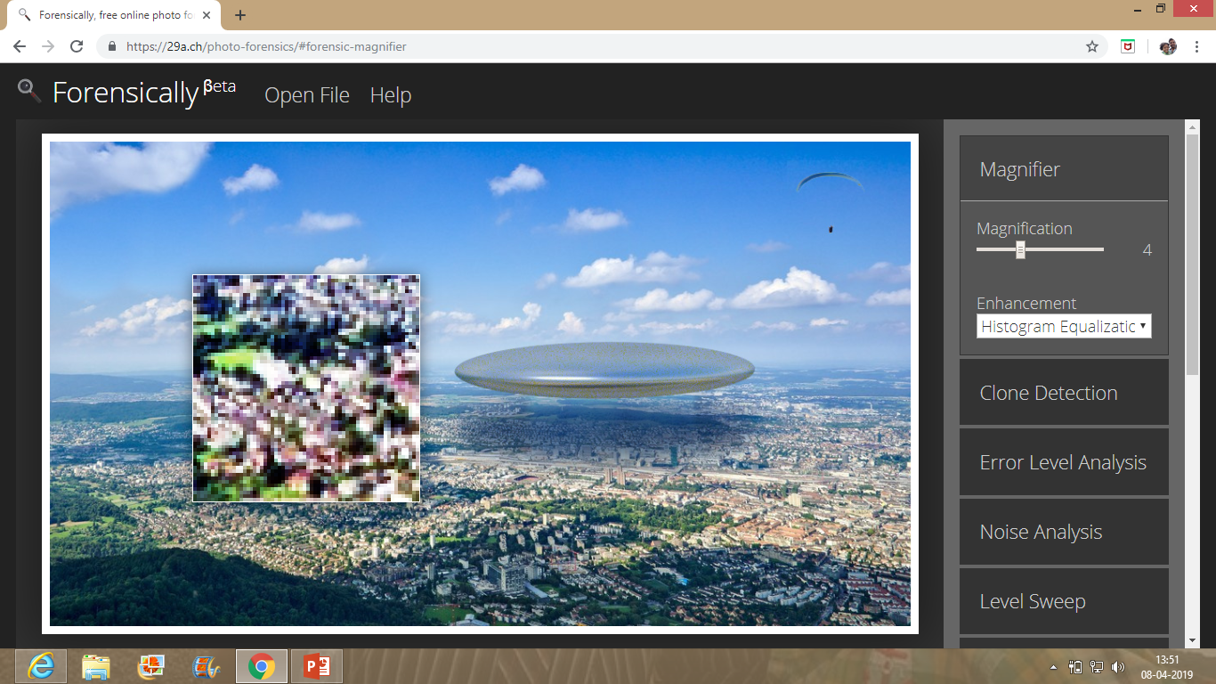
Screenshots

Slide 10
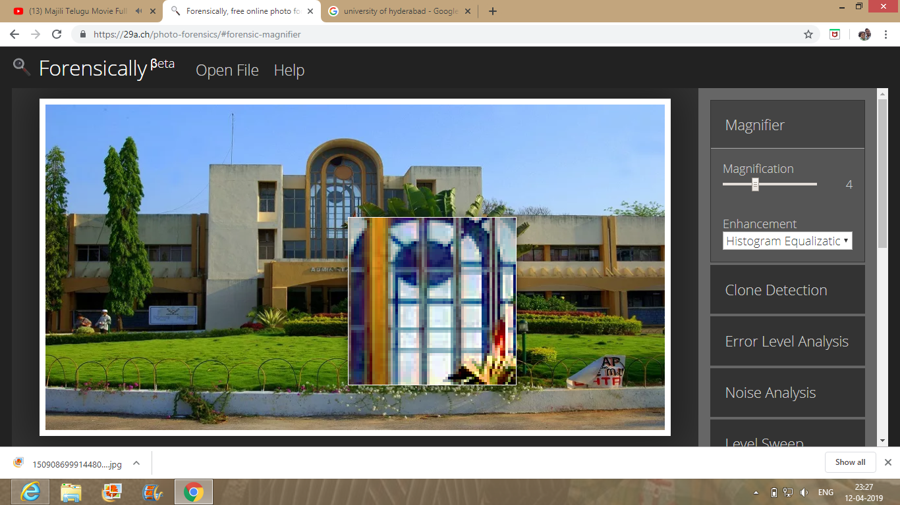
Screenshots

Slide 11
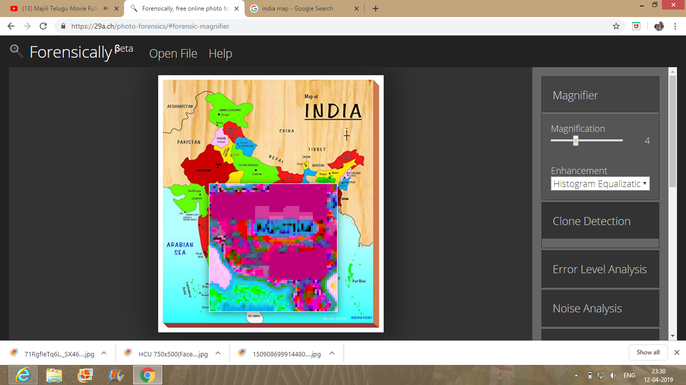
Screenshots

Slide 12
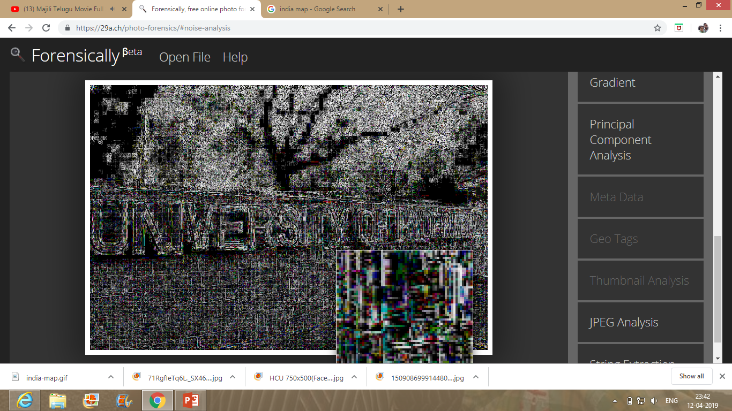
Screenshots

Slide 13
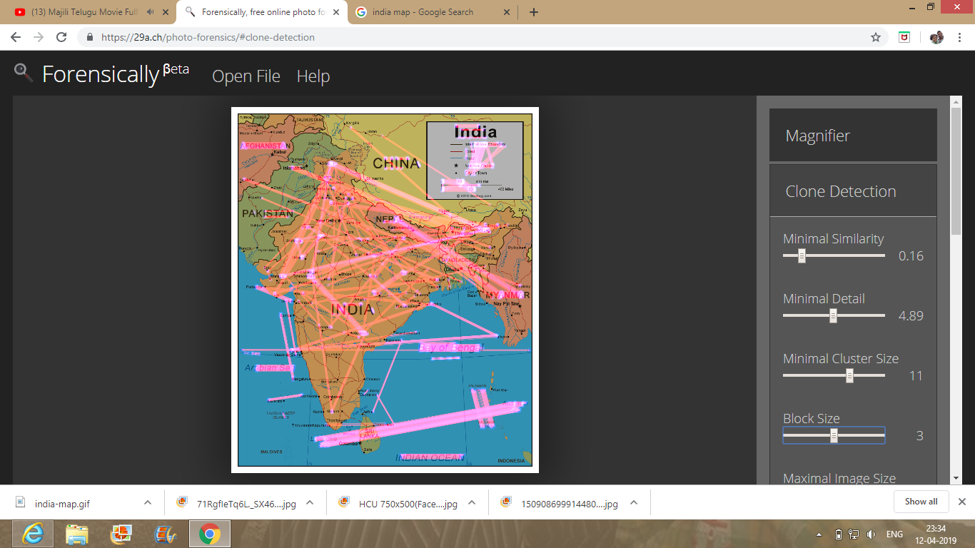
Screenshots

Slide 14
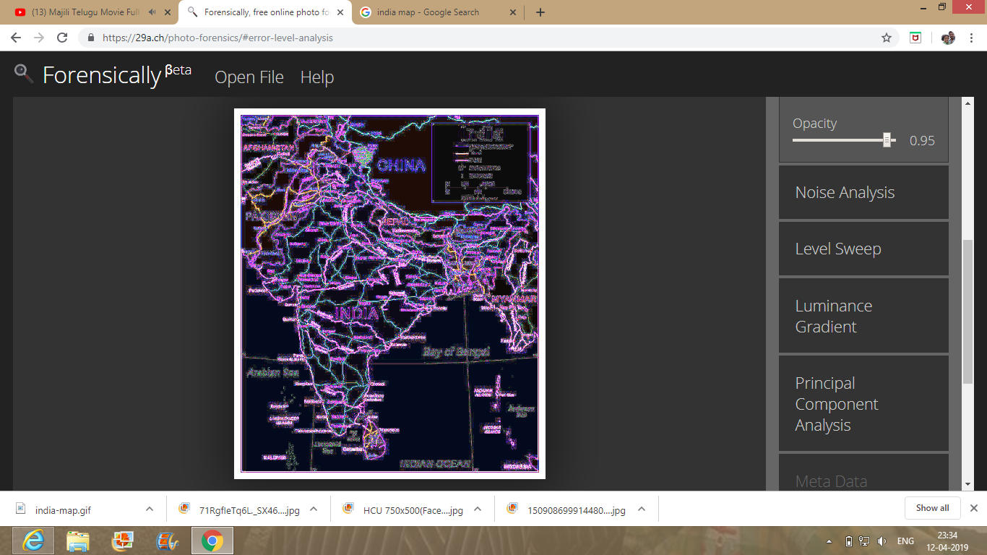
Screenshots

Slide 15
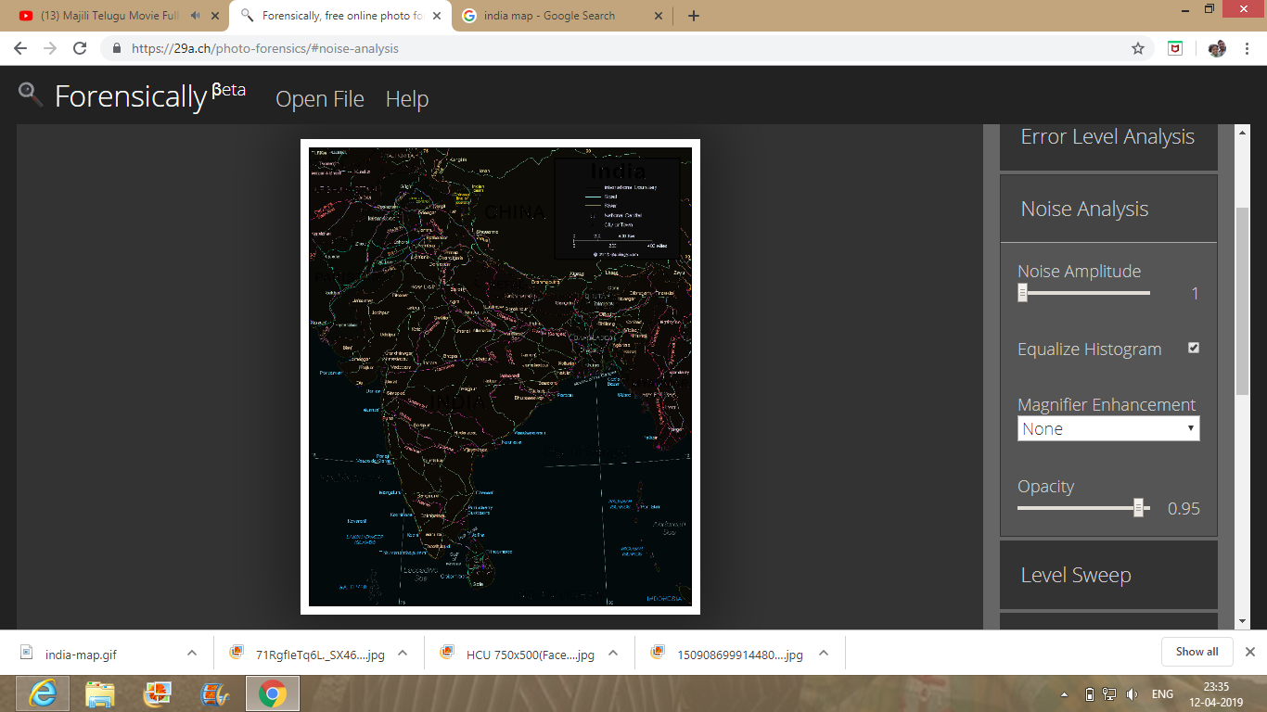
Screenshots

Slide 16
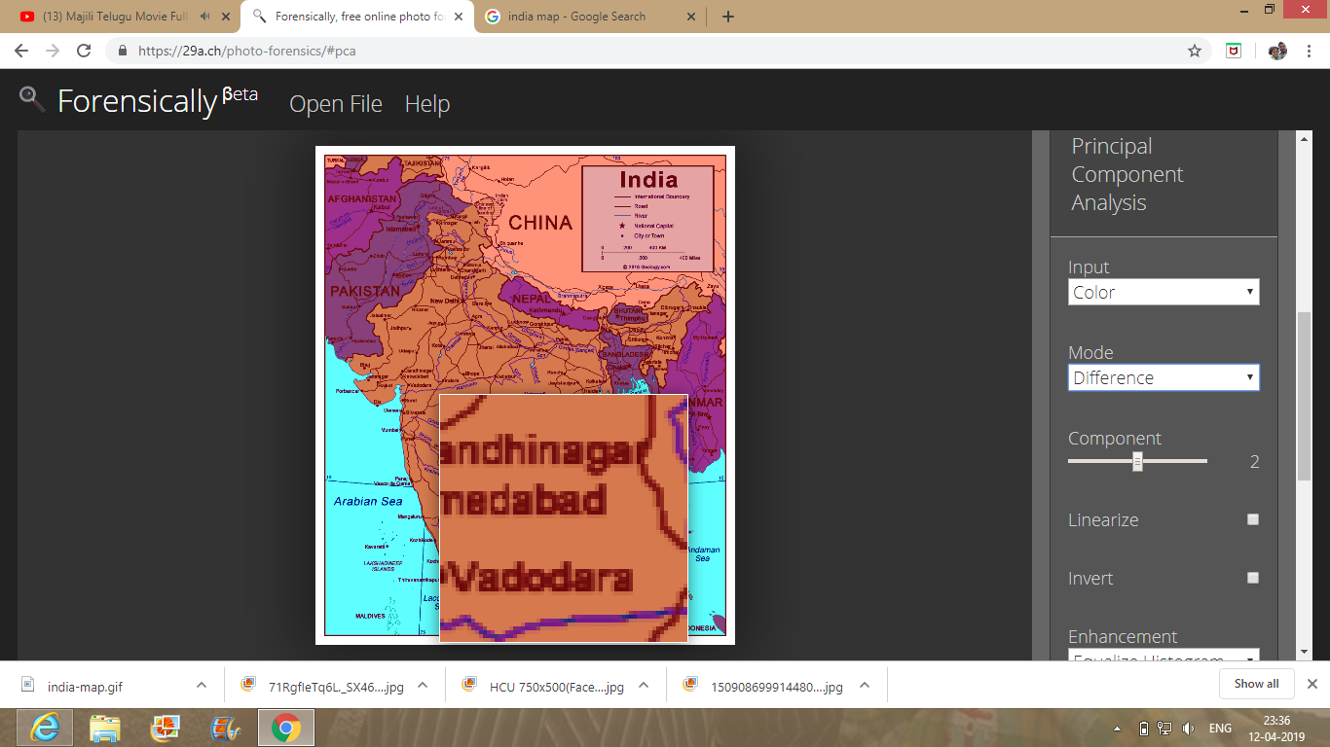
Screenshots

Slide 17
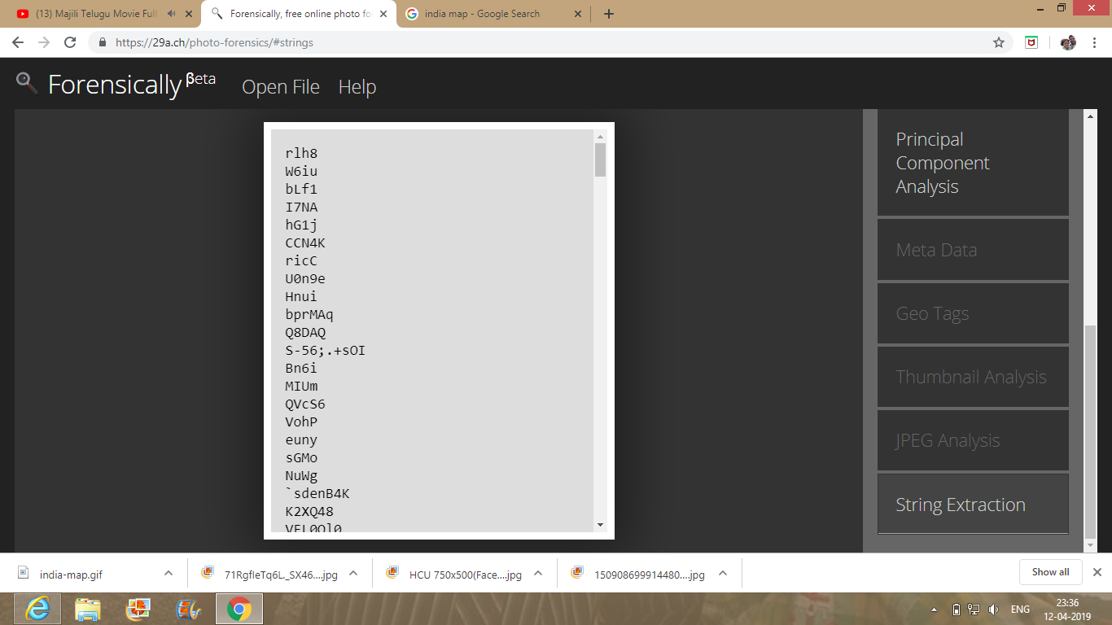
Screenshots

Slide 18
Advantages
Very Simple to Use
It is a open source free web tool.
We have to upload the picture from the computer.
Use it as Offline too.

Slide 19
Disdvantages
This may or may not work it depends on the quality
of morphing of picture.

Slide 20
Conclusion
RAW(A camera RAW image is an unprocessed photograph captured with a digital camera) images are not supported.
The highest quality format we can use is 24-bit PNG(portable network graphics).
There is a community in Facebook and Google+ .
We can take help from that community if any doubts.

Slide 21
References
https://29a.ch/photo-forensics/#forensic-magnifier
https://29a.ch/photo-forensics/#help
https://en.wikipedia.org/wiki/Error_level_analysis

Slide 22
Thank you

